Slide 1
Periodic Metasurface Inverse Design via Deep Learning
Shengnan Han
Graduate mentor: You Zhou
Valentine group

Slide 2
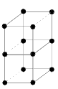
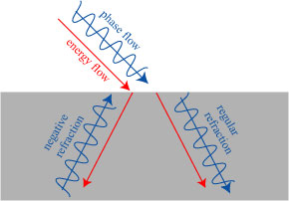
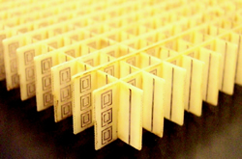
What is metametarial/metasurface?
Natural material
metamaterial
Incident light
Negative refractive index
Positive refractive index
Notes:
Atomic crystal (picture) is composed atoms. Arrangement will determine the optical property
Metamaterial composed of meta atoms. we can control meta atom to control the overall property(pitcture)
Conventional optic material can only have positive refraction
Periodic metasurface is that each unit cell is the same

Slide 3
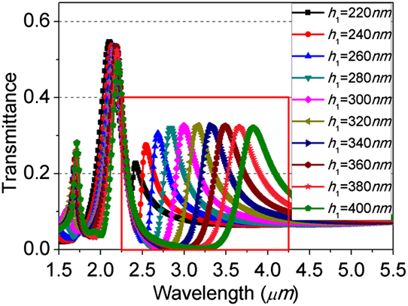
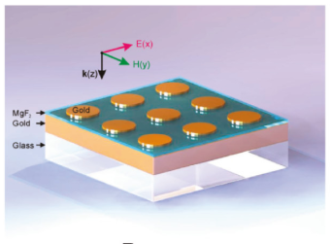
Traditional design process of periodic metasurface
Parameter sweeping.
Change unit cell shape by physical intuition
Pros:
Intuitive
Cons:
Time consuming
Limited tuning parameter
Notes:
Desired spectrum is green line, now we are only have black line
We change h1 gently and find as h1 increases spectrum moves closer to desired spectrum.
We keep increase until we find h1 = 400 is the correct value for h1

Slide 4
Inverse Design for Periodic Metamaterial
Topology optimization and Deep Learning(DL) based inverse design
DL based inverse design:
Periodic
Continuous frequency
All kinds of material
Topology optimization:
Non periodic
Complex but discrete function (discrete frequency)
Not for lossy and dispersive material
Notes:
Two inverse design:
Topology inverse design: is only for diecrete function
Machine learning

Slide 5
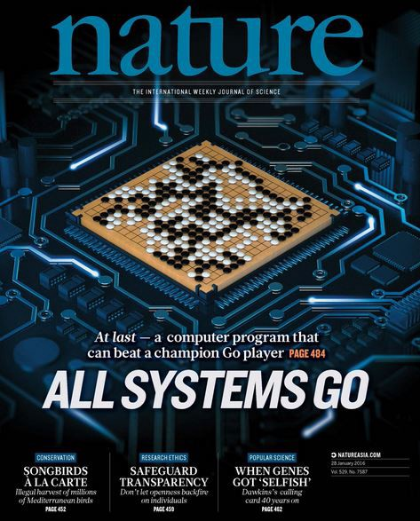
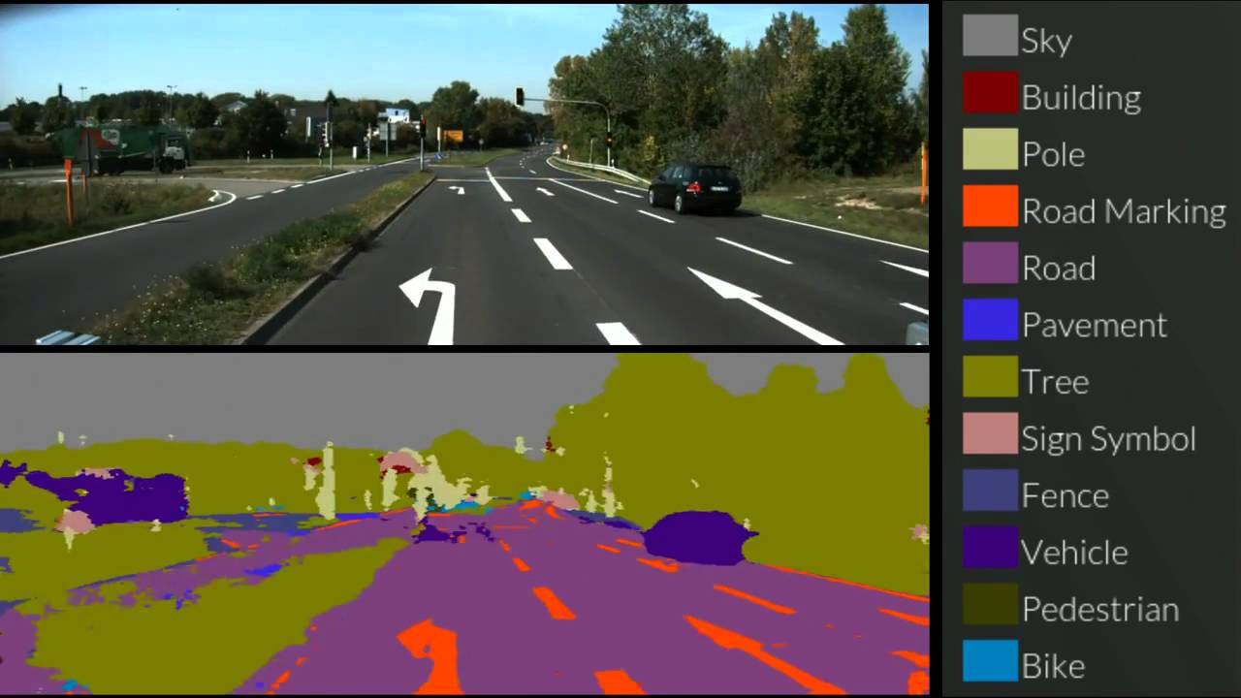
Deep Learning
Credit to Professor Xenofone
Astonishing result
Similar solution to different problem
Big data and computing power
Notes:
What is deep learning?
Hot topic in recent years. Astonishing result
Self-driving cars -> identify obstacles, cars, traffic lights and so on.
GO -> too many possibilities to enumerate all situation, DL not only learns from the past games but also developing its own strategy
Same model can be apply to different games.

Slide 6
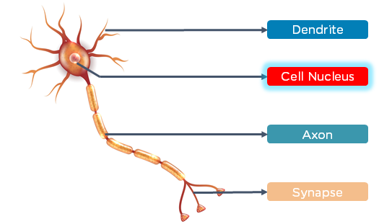
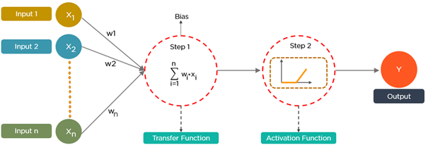
Deep Learning (deep neural network)
Work on the basis of the structure and function of a human brain.
Notes:
A human brain consists of neurons that process and transmit information between themselves. There are dendrites that receive inputs. Based on these inputs, they produce an output through an axon to another neuron.

Slide 7
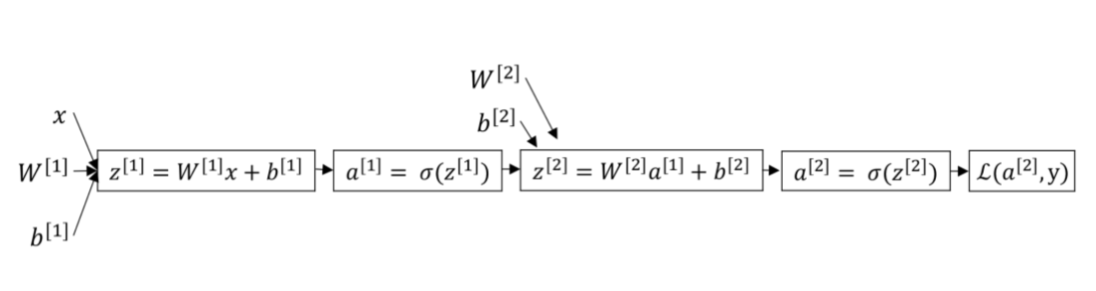
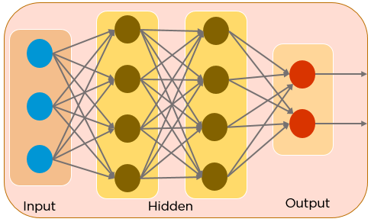
Deep Learning (deep neural network)
Notes:
Supervised learning
Output will be measure by loss function. Loss function compares true label with the predicted label and see how accurate your prediction is.
Loss high -> predicted label not close
Loss low -> predicted is close

Slide 8
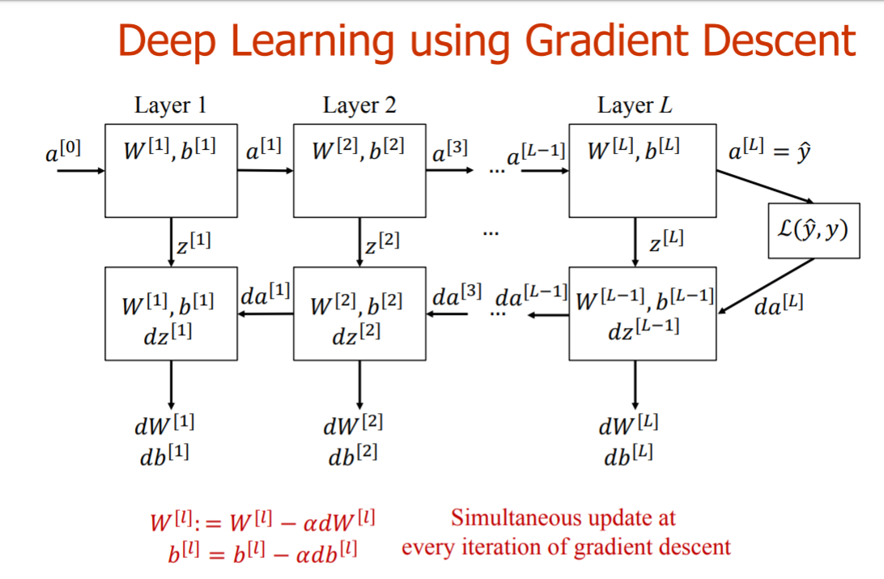
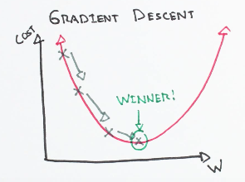
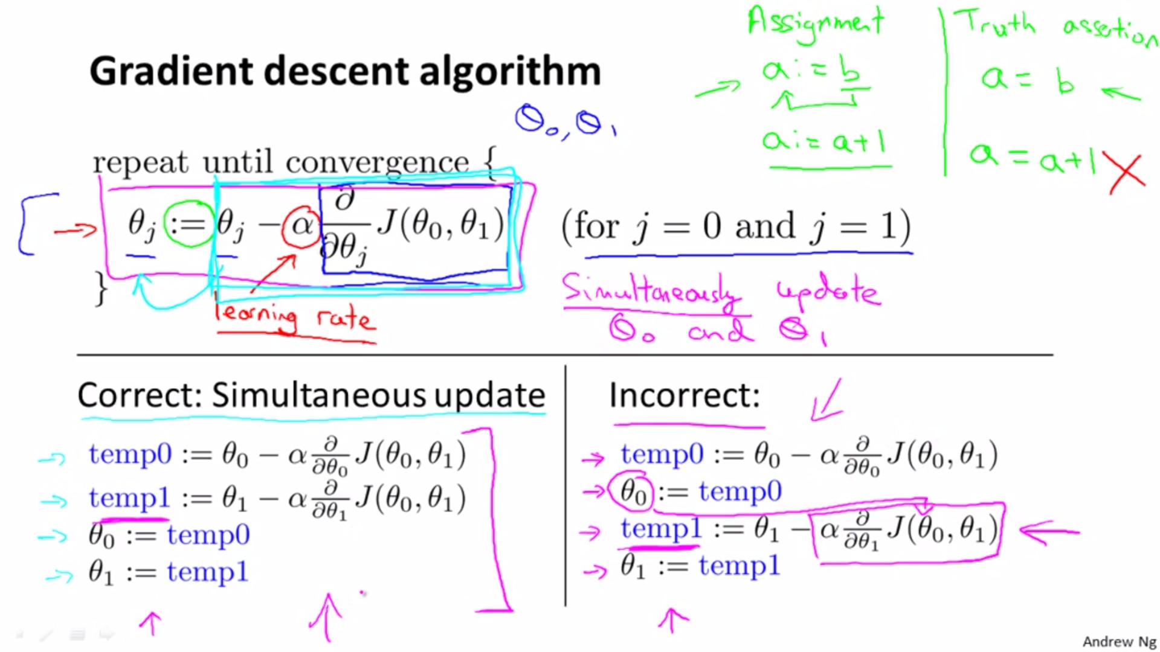
Gradient descent
Notes:
Gradient is a vector that point to the direction where the value of the function increase the most.
Tangent line to the curve moving upwards
What does gradient descent means? Instead of moving to the direction where the value off the function increases the most, we are going to the direction where the value of the function decreases the most. And hope we can find a minimum of the function. So by finding the minimum of the loss function we are getting close to the true label
A0 propagate through each layer and generate predicted label yhat, yhat will compare with the true label y. And we adjust take the derivative and use the chain rules to adjust weight and bias in each layer.
Learning rate = step size

Slide 9
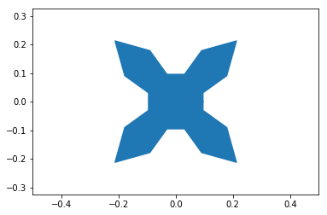
Metasurface Inverse Design via DL
My goal
Cylinder experiment
Data generation
Optimization

Slide 10

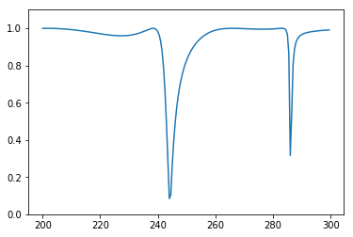
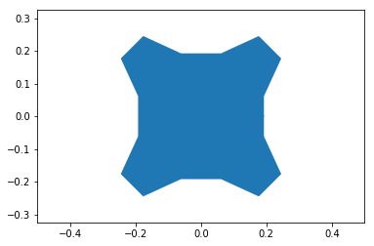
Objective
GOAL: generate metamaterial unit shape based on required spectrum information using deep forward neural network

Slide 11
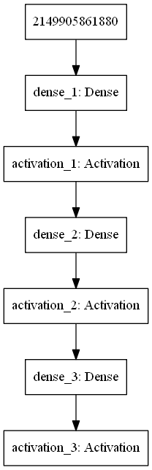
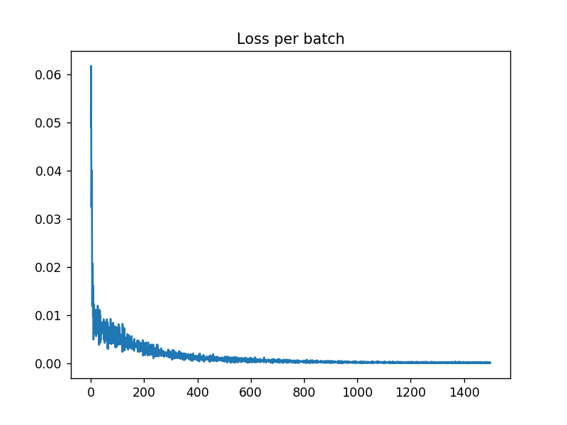
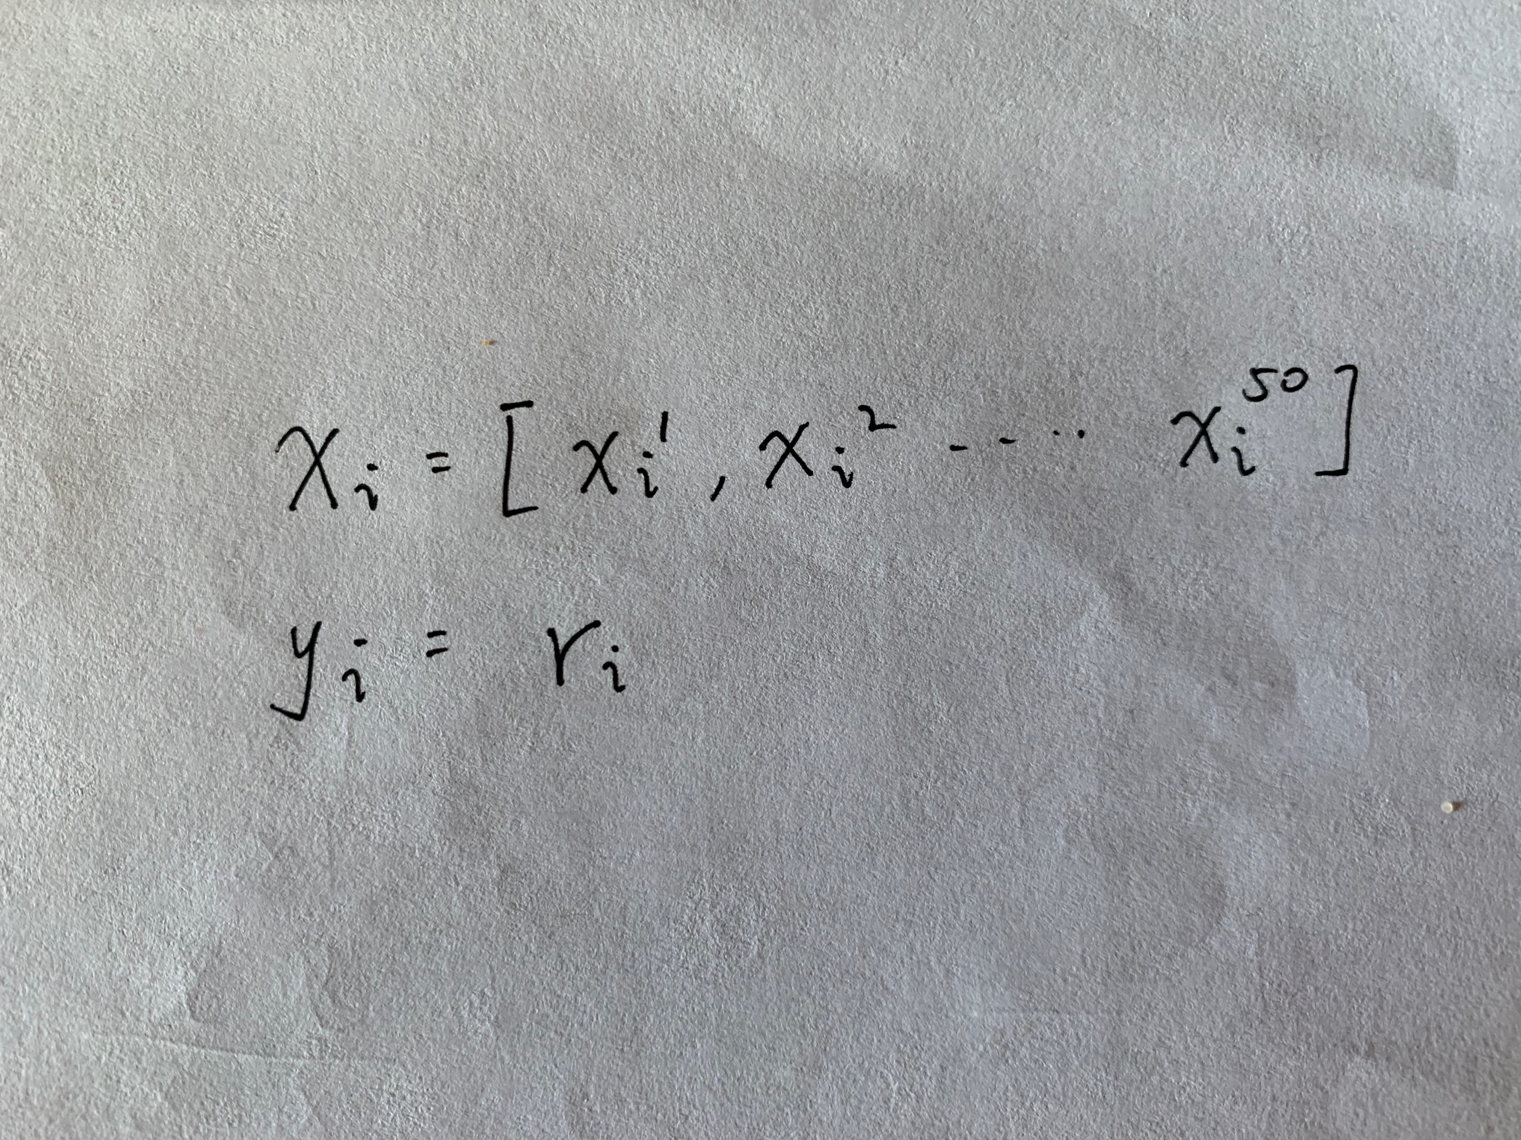
Cylinder experiment
Dataset: X = (41, 50), Y = (41, 1)
Model used:
Notes:
Goal is to predict the radius of the cylinder based on spectrum
X is a 41 sample with 50 points extracted from the spectrum Y is the true radius associate with each of the spcectrum
Training result can be seen on the right, loss for each iteration

Slide 12
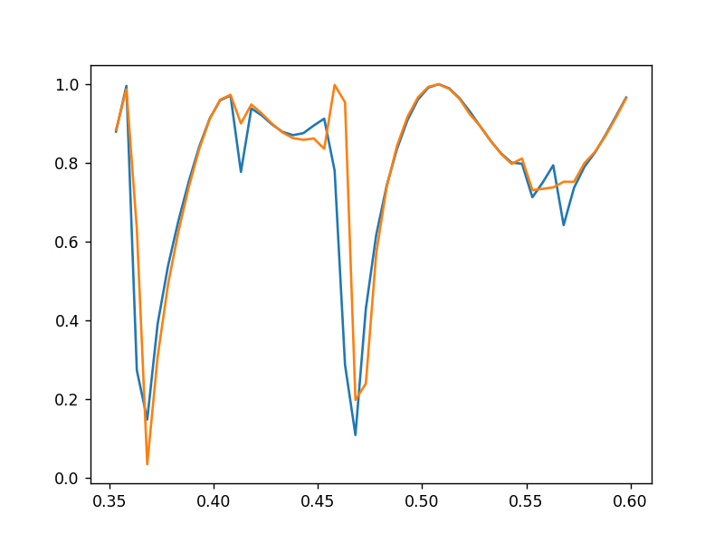
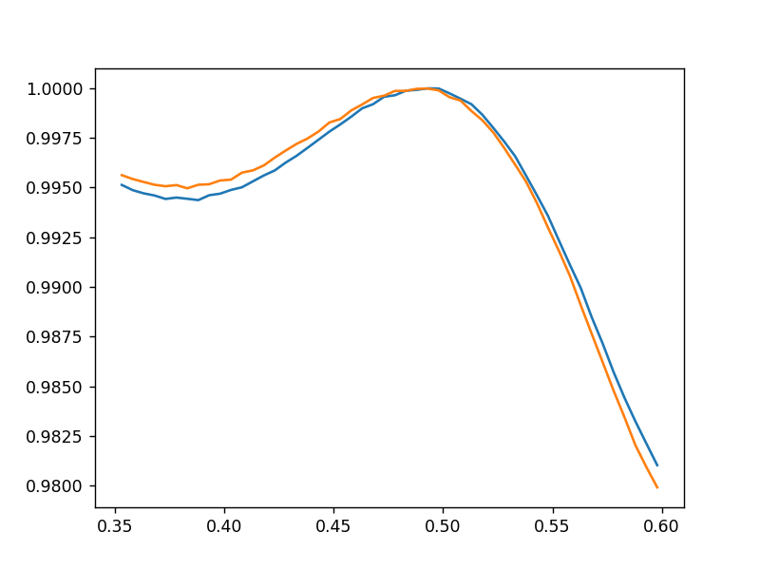
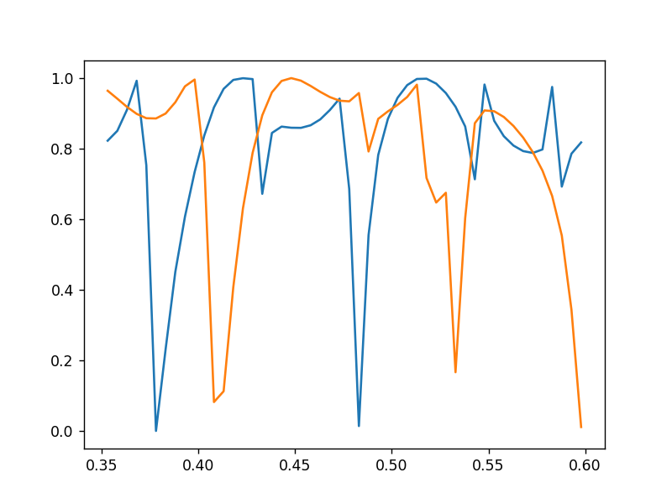
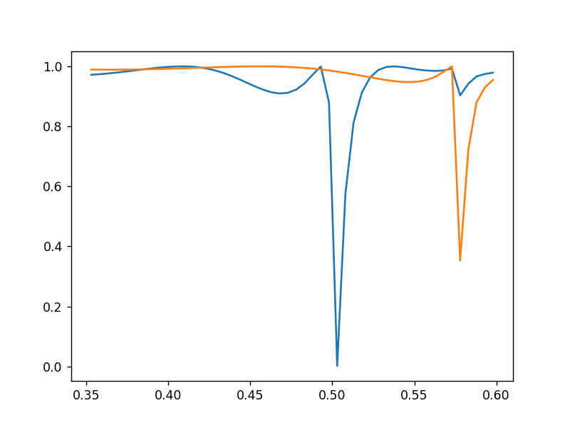
Result
Acceptable prediction in train set = 43%
Acceptable prediction in test set = 10%
True R_norm = 0.40833, Predicted R_norm = 0.4093
True R_norm = 0.14169, Predicted R_norm = 0.14567
True R_norm = 0.3833, Predicted R_norm = 0.3288¶
True R_norm = 0.225, Predicted R_norm = 0.17649
Notes:
Some observation is that High radius have complicate spectrum, low radius have simple spectrum
After seeing some of the sample, I decide that difference between True label and predicted label being under 3.6 nm to be acceptable prediction

Slide 13
Conclusion of Cylinder Experiment
More shape, more spectrum
Different loss function
Different optimization techniques

Slide 14
How to generate dataset?
Rcwa S4:
SetLayerPatternPoly function to generate shape
Generate spectrum based on the shape
CST: examine spectrum

Slide 15
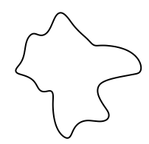


What does the shape look like?
Consideration: Random shape not acceptable
Hard to generate real unit (sharp angle, narrow edge, etc)
Hard to test the result
When light propagate through the unit from y- and x-axis, they should produce the same spectrum
Polarization insensitive metamaterial. Restrain shape into 4-fold symmetry

Slide 16
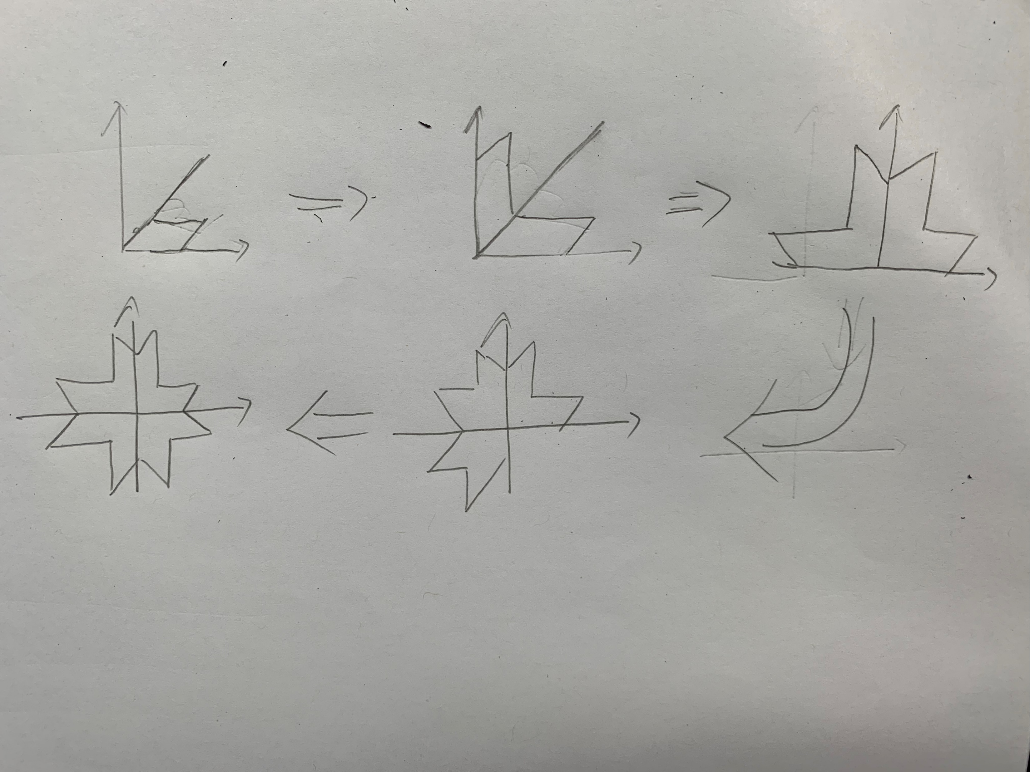
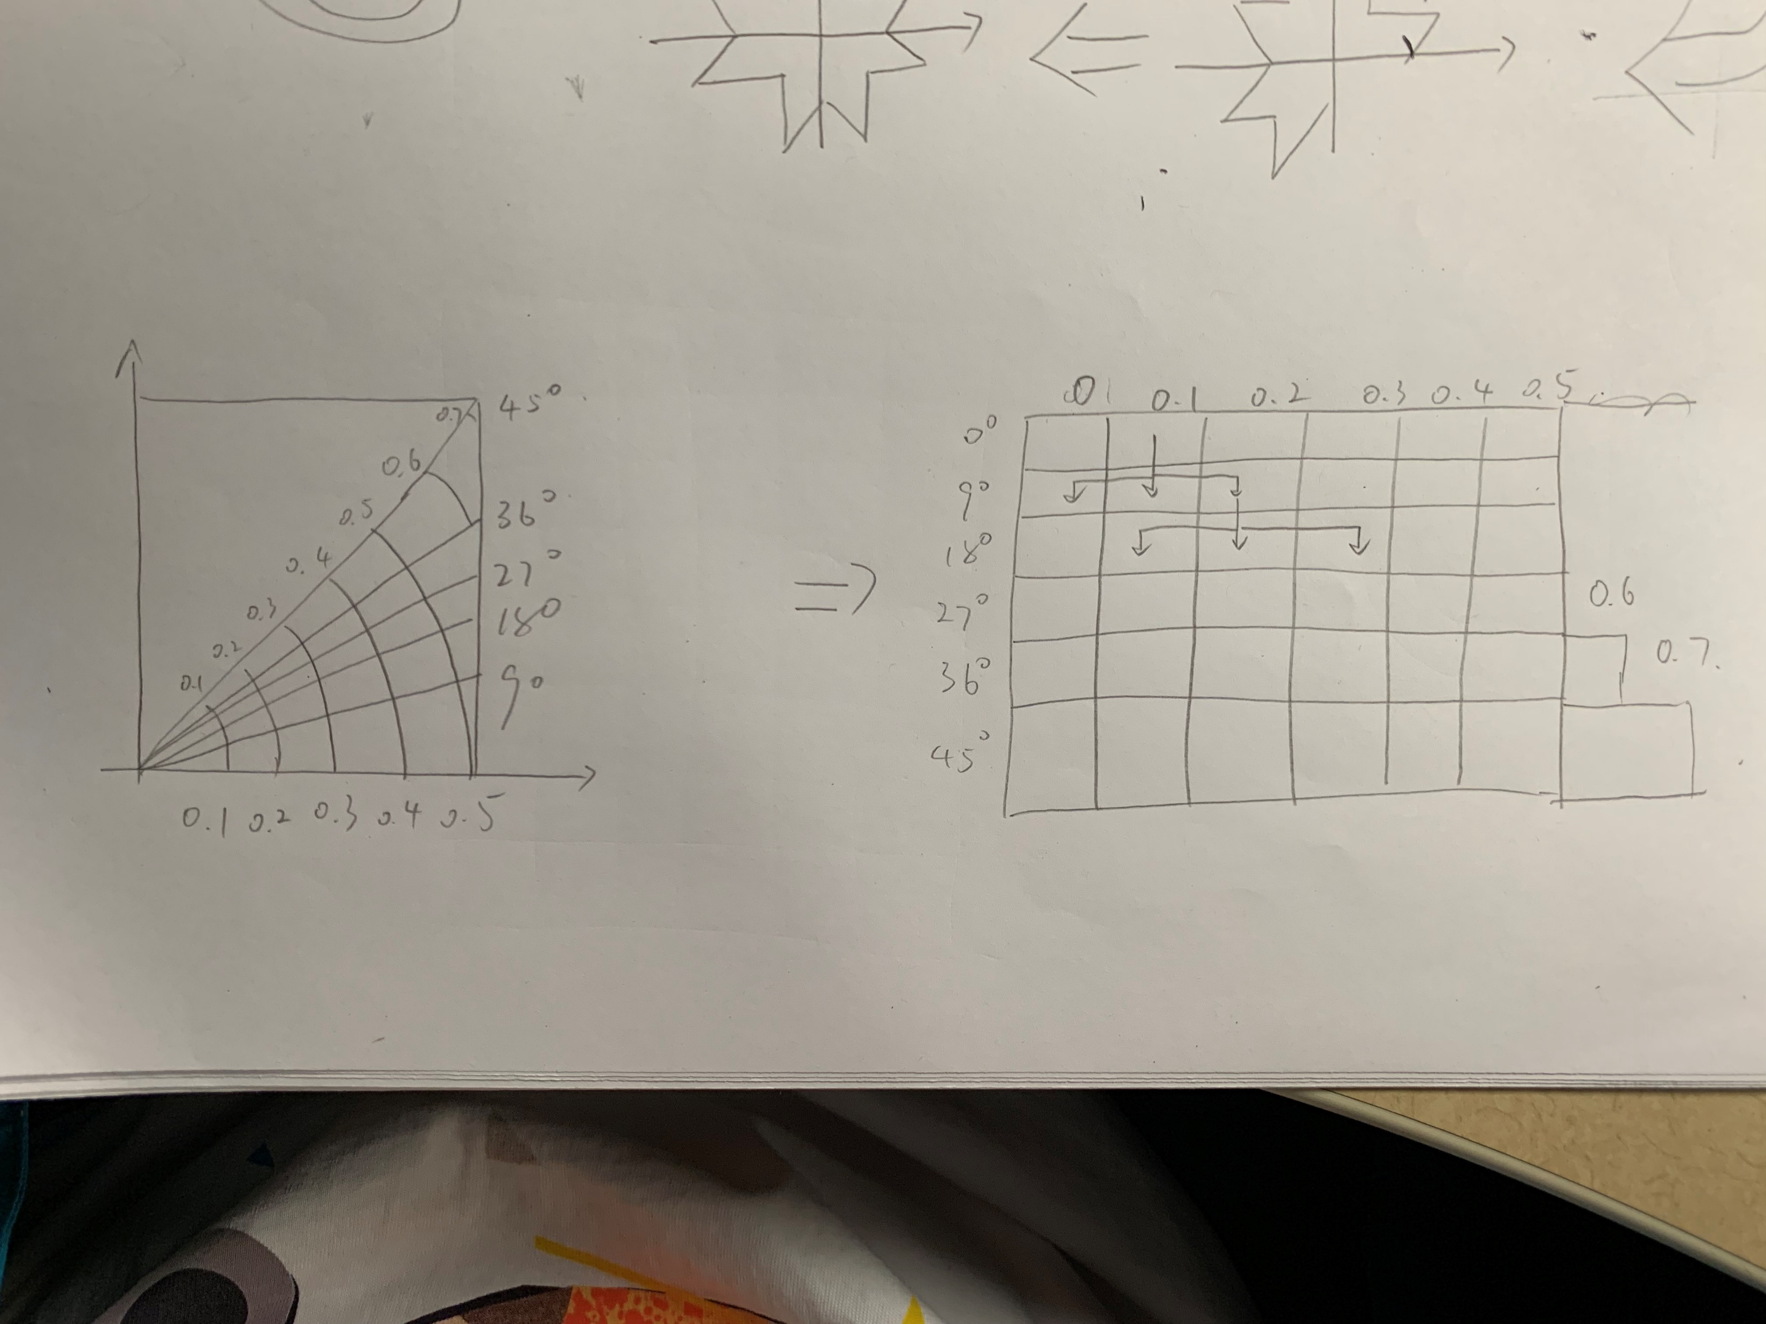
How to generate the shape?
Notes:
Polarization insensitive metamaterial. Restrain shape into 4-fold symmetry
Strategy to generate 4 fold sysmmetry
First, generate a base shape in the first half quauter and apply symmetry to each of the quarter. And eventually generate a full shape
So knowing 1/8 of the shape knows the full shape. We only need to generate 1/8 of the shape
Polar coordinates and transfer it into a 2D array I use dfs algorithm to map through all possible shape combination in the polar coordinate.
Polar coordinate helps better for generating different shape.

Slide 17
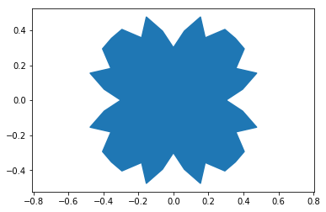
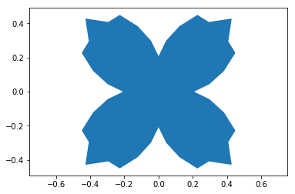
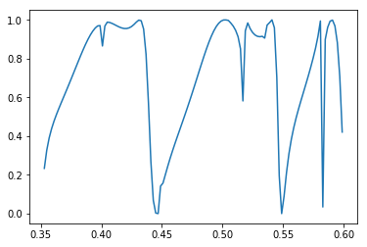
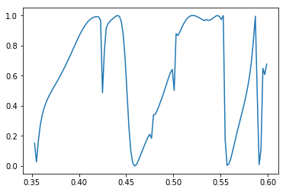
Samples of Random Generated Shape

Slide 18
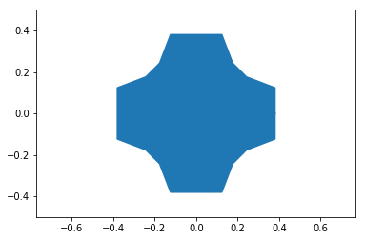
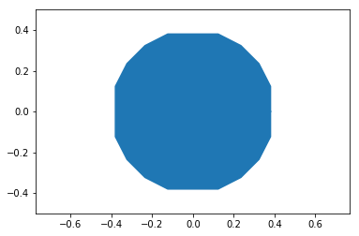
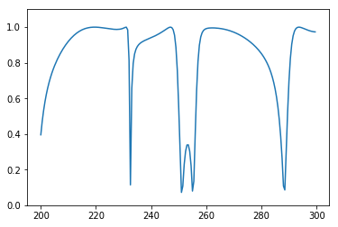
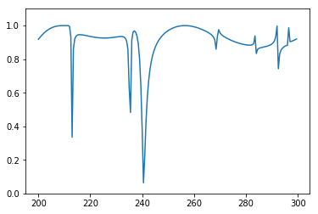
More regular shape created

Slide 19
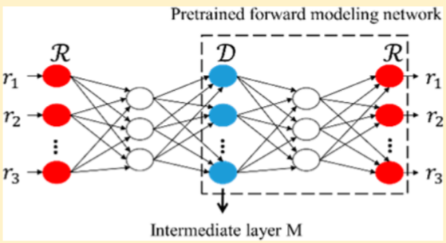
Optimization
Different training method:
Result: Accuracy of training set = 80%, test set = 20%
Different model:
Tandem Neural Network.
Result: Really bad.
Notes:
Each spectrum point value decreased by 0.5

Slide 20
Next Step
Predict base shape instead of radius
Use Accre and wkst to generate more data
Develop coordinate pair training techniques
Test Gan model

Slide 21
Thank you

Slide 22
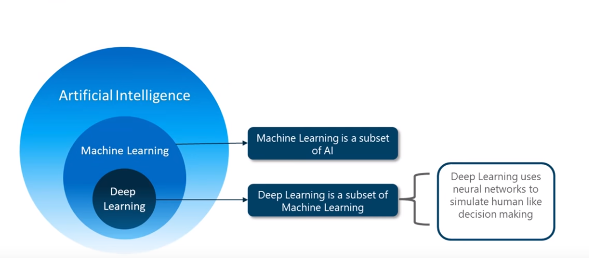
What is AI, ML and DL?
AI is a technique which enables machines to mimic human behavior.
ML uses statistical methods that enable machines to improve with experience
DL makes use of neural networks to simulate human brain like behavior
Notes:
Machine learning is a subset of AI. That is, all machine learning counts as AI, but not all AI counts as machine learning. For example, symbolic logic – rules engines, expert systems and knowledge graphs – could all be described as AI, and none of them are machine learning. The “learning” part of machine learning means that ML algorithms attempt to optimize along a certain dimension; i.e. they usually try to minimize error or maximize the likelihood of their predictions being true. This has three names: an error function, a loss function, or an objective function, because the algorithm has an objective… When someone says they are working with a machine-learning algorithm, you can get to the gist of its value by asking: What’s the objective function?

Slide 23
Previous design process in metamaterial
Enumerate different shapes and find the best shape that can generate the desired spectrum
Construct shape takes too much time (point by point)
If the spectrum required complex polygon, it’s almost impossible to find that shape just based on our imagination and knowledge
NOT INVERSE DESIGN

Slide 24
How do we achieve it?
Use Deep Forward Neuron Network to learn from experience E, with respect to the same task T and performance P, and hope the performance of the task improves with experience.
E: Dataset x containing 4988 samples’ spectrums with 200 points extracted from frequency ranging 200 to 300 and form a vector (4988, 200). True label is 6 coordinates point, which form a vector (4988, 12).
T: Predict 6 coordinate points from transmittance spectrum by neuron network
P: Mean square error and comparison between true spectrum and predicted spectrum
Notes:
Simple words

Slide 25
How do we generate the 1/8 shape?
Use the polar coordinate instead of x-y coordinate
Polar coordinate looks like (length, angle) (l, alfa)
Translate polar coordinate x = l * cos(alfa), y = l * sin(alfa)
Why we use polar coordinates?
Easy to make a closed graph
Easy to make a circle and other shapes
Easy to make multiple different kinds of shape

Slide 26
How do we make multiple graph?
Depth first search!
Consider this as a 2D matrix.
Restrict search process that it only search the points near itself to avoid sharp angle that impossible to be made in the real world

